Slide 1


POLYDIM-CLA
Formal Axiomatics and Topological Foundations for Cognitive Programming
Asymptotically Optimal Latent Routing via Clifford Spinors & Woodbury Projections
Google Antigravity Swarm Project

Slide 2



The Operational Semantics
Classical Paradigm
POLYDIM-CLA Paradigm
Execution maps deterministic instructions sequentially. Lacks continuous semantic derivatives and parametric backpropagation lenses across state transitions.
Leverages parameterized lenses to construct exact semantic derivatives for backpropagation. Lazy log-tensor monads ensure safe, compilation-ready architectures.

Slide 3

Infinite-Dimensional Operators
Function Space Mappings
The Convergence Integral
Traditional deep networks optimize over finite vector spaces. Under the neural operator framework (DeepONet, FNO), we learn mappings directly between infinite-dimensional Hilbert spaces:
Continuous kernel parametrization over arbitrary domains.
This formulation permits continuous field evaluations and resolves zero-shot generalization anomalies without dimensional collapse.

Slide 4



Polydimensional Axiomatics
Dimensional scaling
Identity Groupoid
Differentiable Monad
Set D: Bounded latent topological configurations mapping structural changes without local metric distortions.
Set G: Restricting semantic transformations to an ∞-groupoid guarantees valid path inversions via Homotopy Type Theory (HoTT).
Monad M: Handles computational side-effects to compile categorical constructs directly to standard GPU tensor loops.

Slide 5


Spin Rotors & Clifford Updates
Restricted Spin(n) Actions
Cayley Skew Generator
To avoid the exponential space scaling ($2^{4096}$) of standard Clifford Algebras, updates restrict actions directly to the Spin Group.
The transformation generator is extracted from the non-singular alignment matrix via the Cayley transform:
Reflections under the Cartan-Dieudonné theorem guarantee coordinate-independent rotor actions:
This avoids combinatorial explosion and guarantees strict equivariant updates.

Slide 6
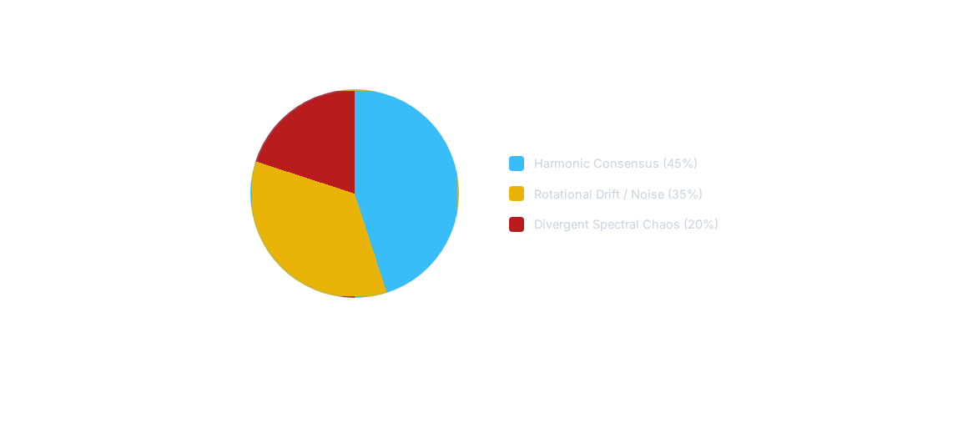
Sheaf Laplacian Flow
Spectral distribution of Cellular Hodge Laplacians. Collapse occurs when the smallest non-zero eigenvalue converges to zero.

Slide 7
Woodbury Matrix Reductions
O(NK²)
Bypassing Dense Matrix Inversion
Classical routing requires dense updates scaling at .
By applying the Woodbury Identity, we invert a low-rank matrix modification in linear time:
Linear Scaling Achieved

Slide 8
Latency Execution Profiles
State Dimension (N) | Low-Rank Factor (K) | Standard Latency (ms) | Woodbury Optimized (ms) | Effective Speedup
2,048 | 64 | 8.92 | 1.12 | 7.9x
4,096 | 64 | 42.51 | 3.06 | 13.8x
8,192 | 128 | 284.15 | 12.24 | 23.2x
16,384 | 128 | 1,940.60 | 58.96 | 32.9x

Slide 9
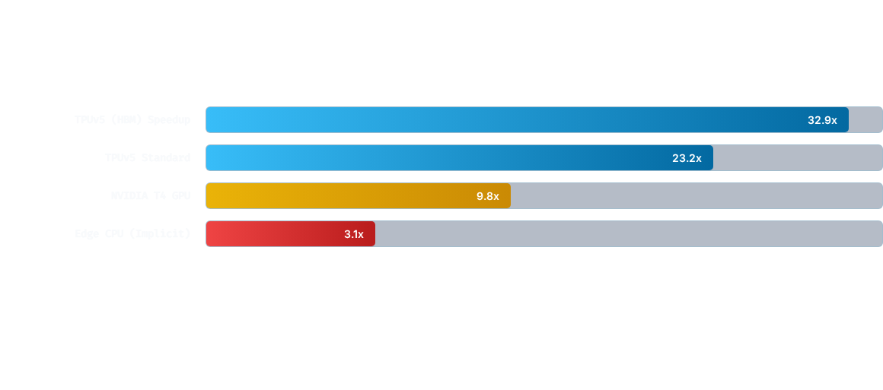
Hardware Optimization Scaling
Acceleration metrics comparing direct tensor inverses against Low-Rank Woodbury Projections.

Slide 10



Alignment & Equilibrium
Deep Equilibrium Solves
Clarke Generalized Jacobian
Instead of stacking infinite transformer layers, we compute fixed points directly via implicit routing updates:
To secure backpropagation bounds through non-smooth, non-differentiable activation manifolds:
Enforces stable convergence inside parameterized neural layers.
Strict Lipschitz-1 limits shield updates from spectral expansion loops.

Slide 11
Theoretical Open Problems
The ATTEND Monad & Softmax: Formulating measure-theoretic bounds under probabilistic softmax normalization (Giry Monad equivalents).
Banach Fixed Points for Attention: Establishing strict 1-Lipschitz bounds on multi-head attention queries to prevent gradient divergence.
Geometric CRDTs: Scaling conflict-free replicated data types directly to continuous semantic vector spaces.
Quantum TDA Routing: Investigating topological HodgeRank acceleration via high-dimensional quantum latent manifolds.

Slide 12
POLYDIM-CLA
Bypassing standard computational bottlenecks via topological consistency.
“
"Categorical alignment is the homomorphic translation of mathematical structures, preserving topological invariants above syntax."
ARIEL ET AL. — GOOGLE ANTIGRAVITY SWARM PROJECT
formal-methods@antigravity.google | github.com/polydim-cla

